Slide 1
TYPES OF VIDEO AD
Skippable Ad=Ad which we can skip
Non skippable Ad which we cannot skip
Bumper Ad=Small non skippable ad
DiscoveryAd=Discoveryads are displayed automatically on YouTube Home and Watch Next feeds
Youtube masthead=Is placed on youtube homepage for all
Sequential ad=Ad which are shown in parts eg teaser trailer launch

Slide 2
TARGET
Demography=(age,gender,location)
Detailed Demography=(Education,Occupation,Marital Status,Parental status)

Slide 3
Audience segments
AFFINITY=(Broad)People who are indirectly related to my product
IN MARKET=(Niche specific)People who are actively researching for your product OR people who are “IN MARKET” for your product
KEYWORD=Search Terms (How are people searching for my business)
TOPIC=(BROAD) Category (ON WEBSITE OR VN-VIDEOS)
PLACEMENT=(Niche specific) Exact URL’s
DEVICE=Can target specific device(Ios android desktop)
LANGUAGE=Default Browser Language

Slide 4
IMPRESSION,REACH,FREQUENCY
IMPRESSION=No. of times the ad was shown
REACH=No. of people exposed to my ad
UNIQUE REACH=Unique no. of people exposed to your ads across any device or platform
FREQUENCY=Average no. of times ad is shown to one person
IMPRESSION/REACH=FREQUENCY

Slide 5
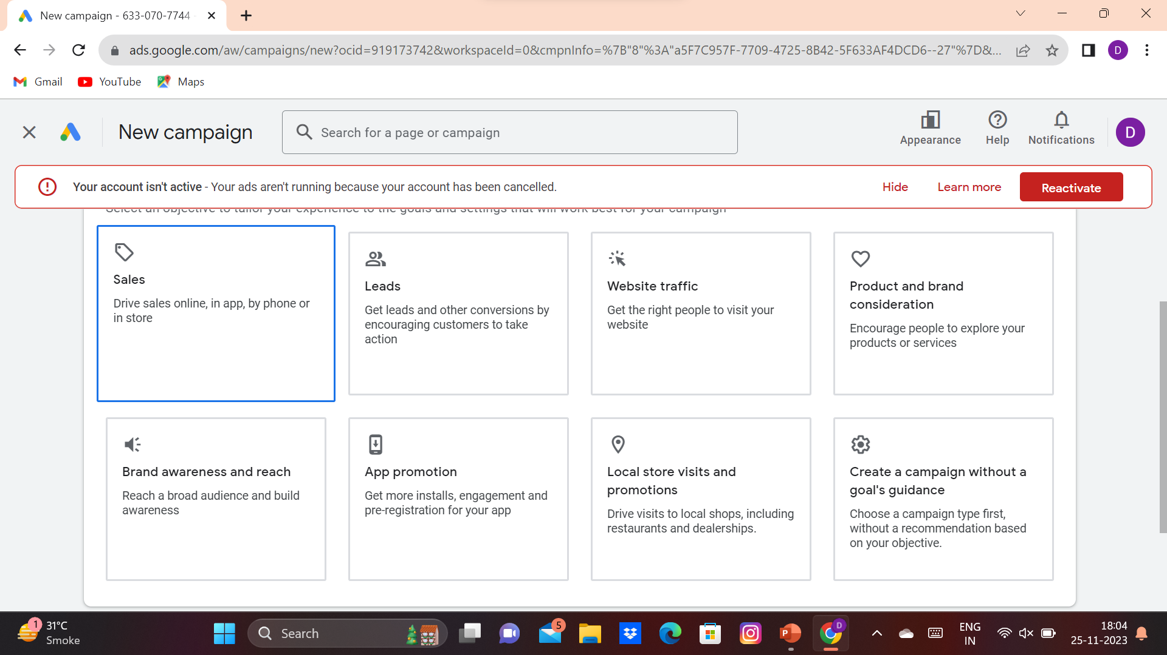
Objectives of AD campaign why are we creating the ad campaign? what is our motive or objective?

Slide 6
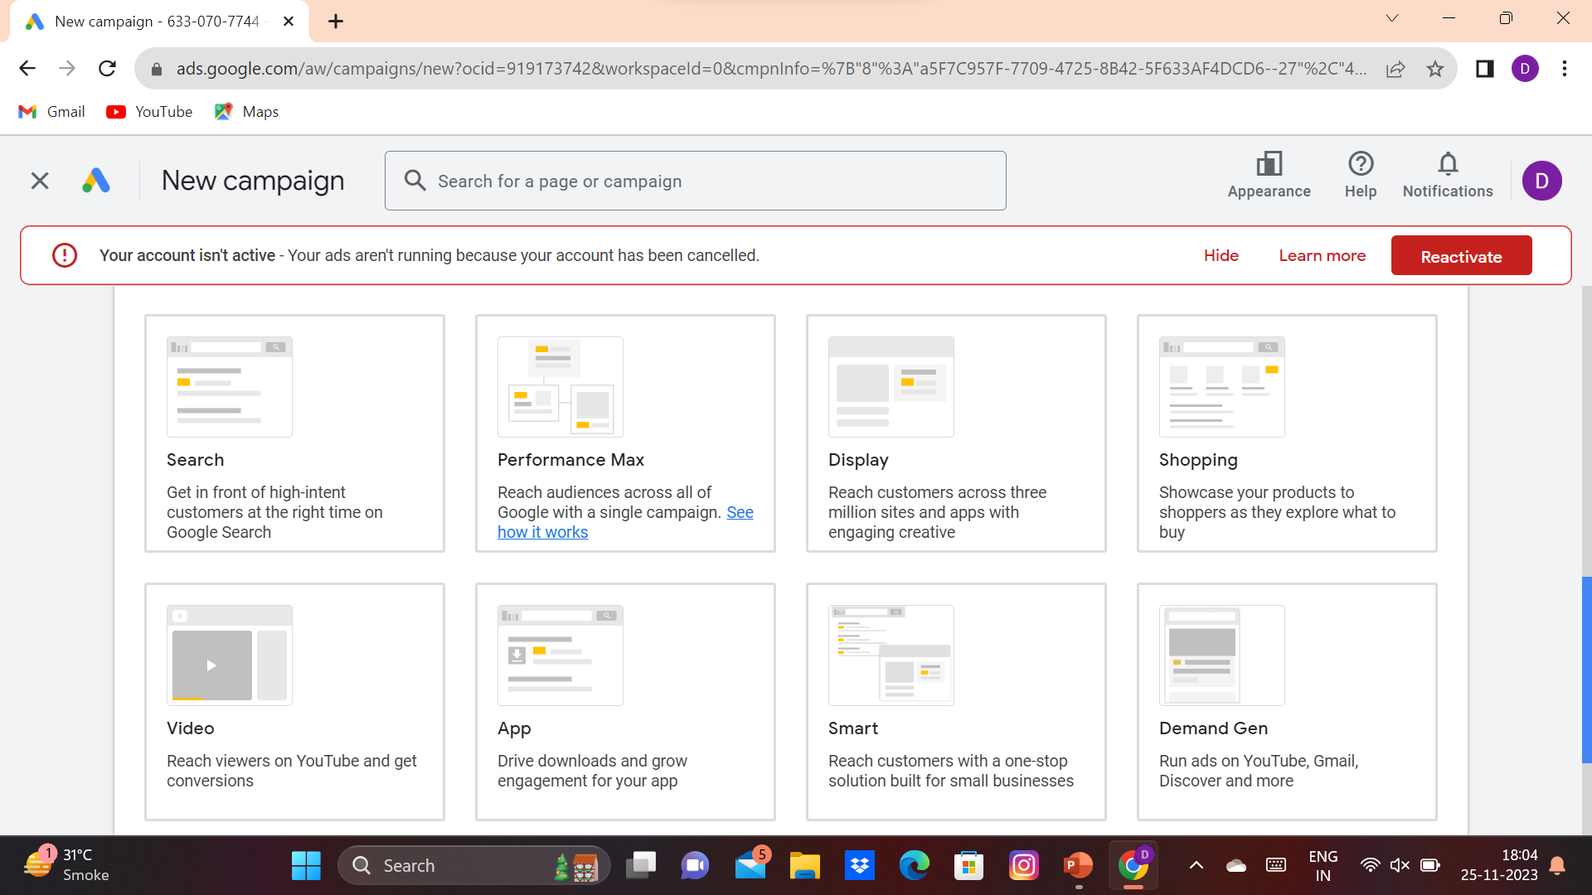
CAMPAIGN TYPE: In which way the ad campaign will reach to the audience eg.videos ad

Slide 7
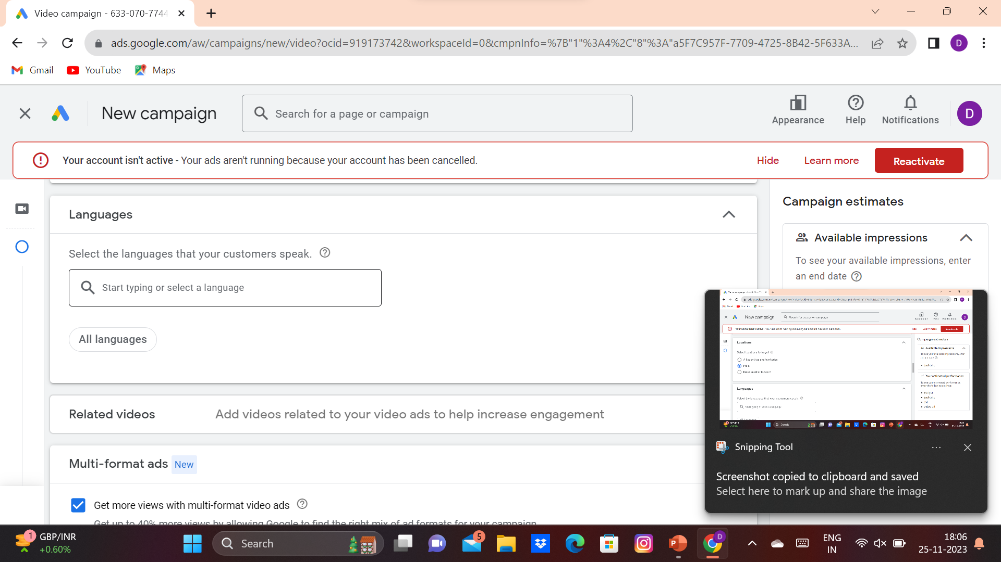
LANGUAGES: In what language you want to show your ad to the audience any specific language or all language is which you can use

Slide 8
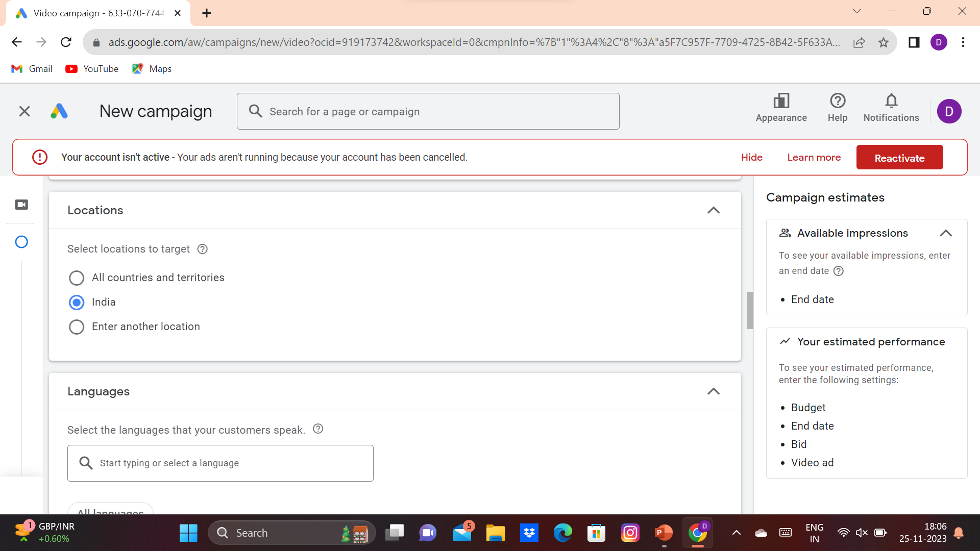
LOCATION In the whole country or particular state or cities or area(pincode) can be targeted and only the targeted location will able to see your ad

Slide 9
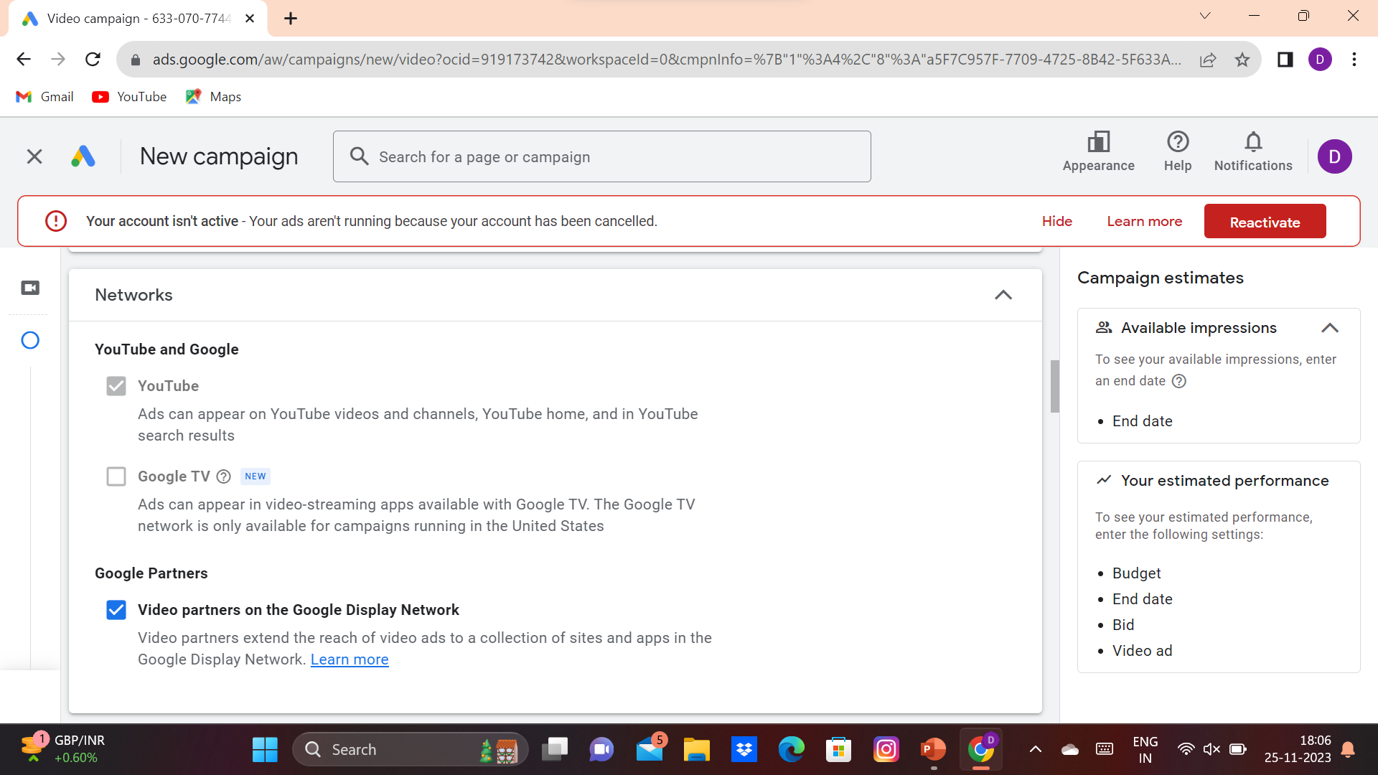
NETWORKS Where do you want your ad to be displayed

Slide 10
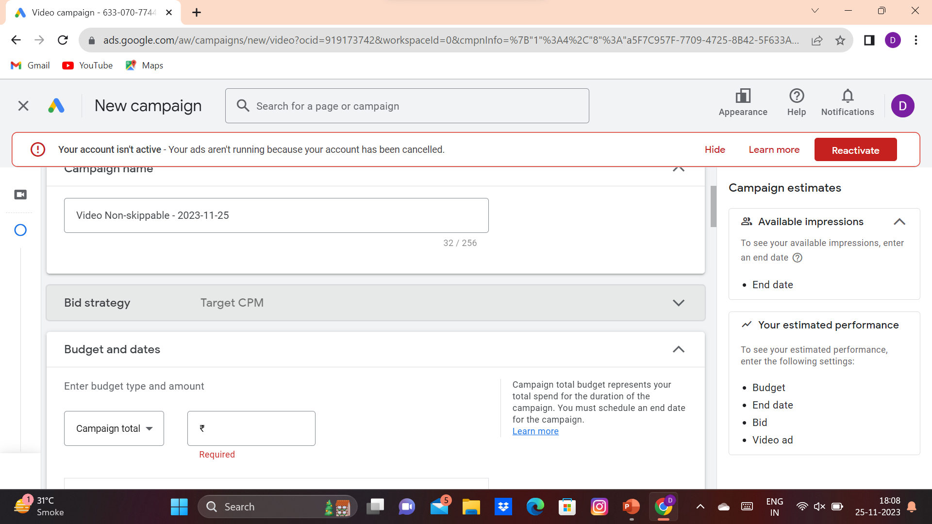
BID STRATEGY If we have choosen non skippable ad the bid strategy would be cost per mile(CPM)It means the company will pay the amount on 1000 impression received instead of 1 impression .

Slide 11
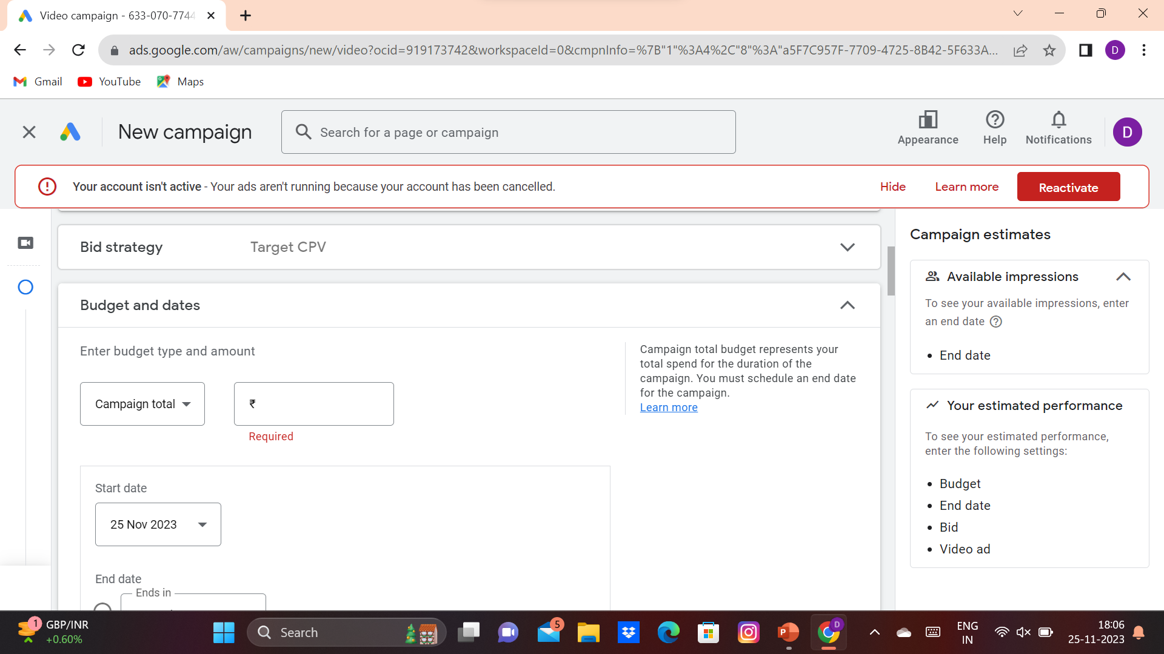
CPV Cost per view is used in skippable ad where if the viewer watches more then 50% of your content then it is called as view

Slide 12
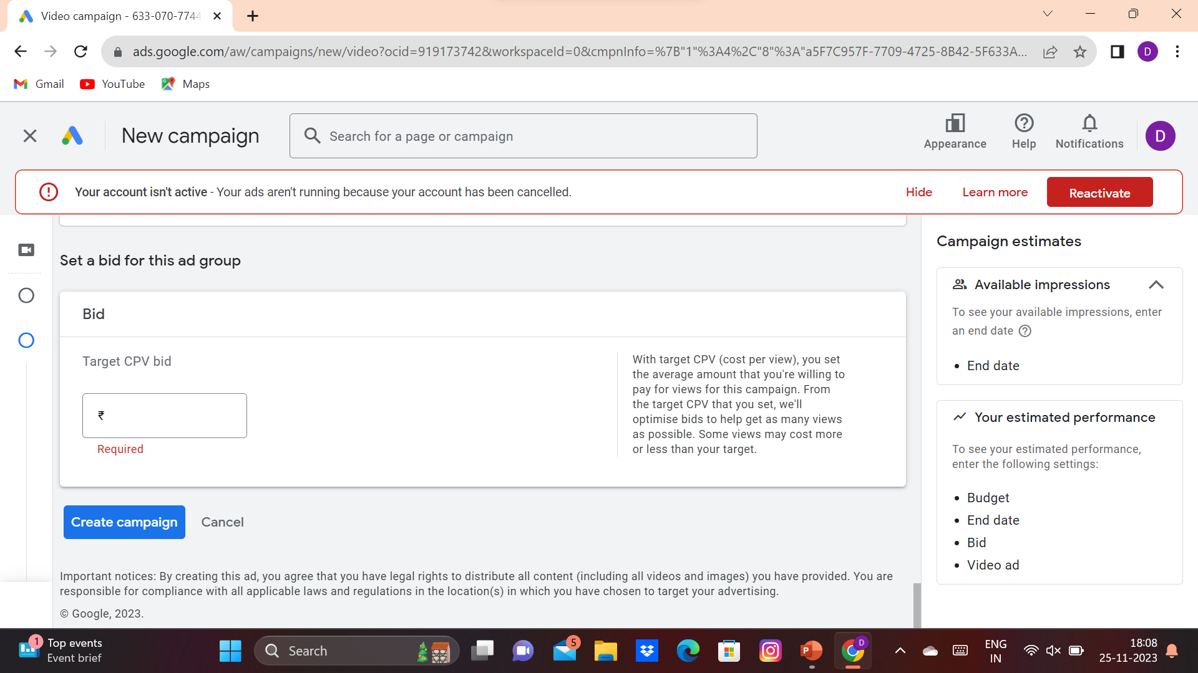
BID bid is the amount we have to pay for per view of our ad campaign

Slide 13
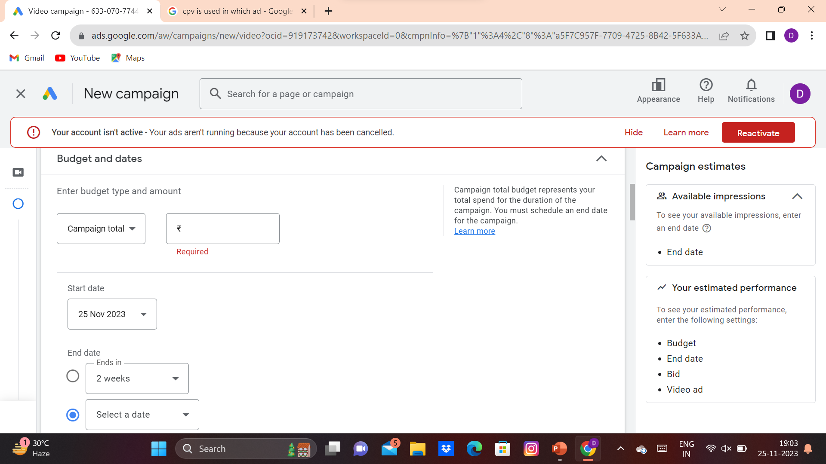
BUDGET AND DATE Budget is the amount we have for running our ad campaign for the time period set the start date and end date is needed There are two types of budget daily and total in daily budget the budget is set for daily ad and in total the the budget is not well controlled and can be exhausted and the amount will be paid at the end of the campaign

